Slide 1
Developing Integration Solutions using Microsoft BizTalk Server 2016
Maps

Slide 2

Course Outline
Module 1: Introduction to BizTalk Server
Module 2: Schemas
Module 3: Maps
Lesson 1: Creating a BizTalk Map
Lesson 2: Configuring Basic Functoids
Lesson 3: Configuring Advanced Functoids
Module 4: Testing and Deploying Projects
Module 5: Pipelines
Module 6: Routing
Module 7: Adapters
Module 8: Web Services and WCF
Module 9: Introduction to Orchestrations
Module 10: Applied Orchestration Techniques
Module 11: Business Activity Monitoring
Module 12: Integrating Business Rules
Module 13: Deploying and Managing Applications
Module 14: Windows Azure BizTalk Services

Slide 3
Lesson 1: Creating a BizTalk Map
What Is a BizTalk Map?
Creating a Map by Using the BizTalk Mapper
Creating Links
Basic and Complex Map Links
Validating and Testing a Map
Demonstration: Creating and Testing a BizTalk Map

Slide 4
Transform messages
A map transforms data from one schema to another
Source Schema
MAP
Destination Schema
Order
Order
<
>
OrderID
<
>
OrderNummer
<
>
OrderDate
<
>
Datum
Customer
Kund
Rows
Rader
OrderRow
OrderRad
<
>
ProductID
<
>
Namn
<
>
Name
<
>
ID
<
>
Qty
<
>
Antal
<
>
Price
<
>
Pris
Source and destination schemas must be part of the project or contained in a referenced assembly

Slide 5
Basic and Complex Map Links
Simple
Blog
Feed
Most common type of mapping
Values simply copied from input message to output message
Supports most types of transformations and translations
<
Title
>
<
>
Title
<
Content
>
<
>
Link
Author
Author
DateTime
Desc
Url
Complex
Blog
Feed
Manipulate data using functoids
Used for variable count record mapping
<
Title
>
<
>
Title
<
Content
>
<
>
Link
Author
Author
DateTime
Desc
Url

Slide 6
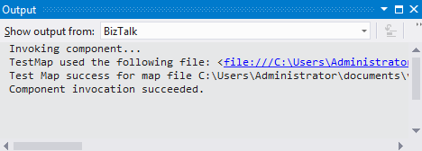
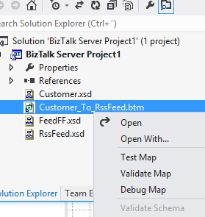
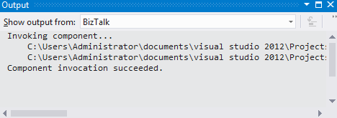
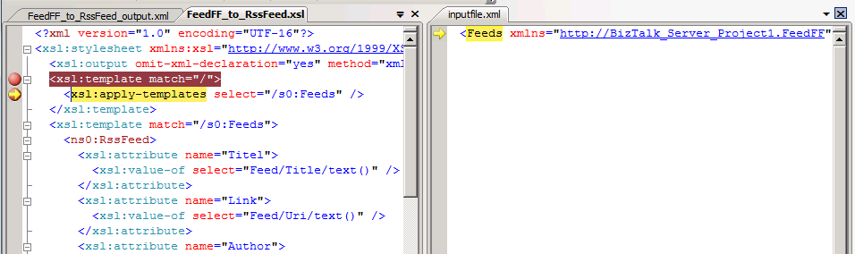
Validating and Testing a Map

Slide 7

Demonstration: Creating and Testing a BizTalk Map
Use the BizTalk Mapper
Add source and destination schemas to the map
Create a simple link
Automate multiple links
Test and validate a map
Notes:
(Slide 7)
Open the solution at: C:\Demos\Mod3\Start\Mod3Demo1.sln
Select the project. Add – New Item.
Name the Map Customers_to_Contacts
Create links, Map LastName to Name, ContactNo to ContactRef
Set C:\Demos\Mod3\Start\Customers.xml as input instance
Validate Map
Open the existing map Customer_to_Customers2
Demonstrate AutoLink (shift-link)

Slide 8
Lesson 2: Configuring Basic Functoids
Data Manipulation with Functoids
Using Basic Functoids
Adding Functoids to a Map
Using Map Grid Pages
Demonstration: Adding Functoids to a Map

Slide 9
Data Manipulation with Functoids
Source Schema
MAP
Destination Schema
Order
Order
<
>
OrderID
<
>
OrderNummer
<
>
OrderDate
<
>
Datum
Customer
(..)
Kund
Rows
Rader
OrderRow
OrderRad
<
>
ProductID
<
>
Namn
<
>
Name
Functoids
<
>
ID
<
>
Qty
<
>
Antal
<
Price
<
Pris
>
Use to manipulate mapped data
Can use predefined functoids or create custom functoids
Custom functoids can call scripts
>

Slide 10
Basic Functoids
Category | Usages
Conversion | To convert to and from ASCII and between numeric bases, such as hexadecimal and octal
Cumulative | To perform mathematical operations in looping records, such as averages and concatenation
Date and Time | To retrieve the current date and time, and to calculate delta times
Logical | To perform a variety of logical operations, such as greater than and logical existence
Mathematical | To perform a variety of mathematical operations, such as addition and multiplication
Scientific | To perform a variety of scientific operations, such as logarithms and trigonometry
String | To perform a variety of string functions, such as trimming and concatenation

Slide 11
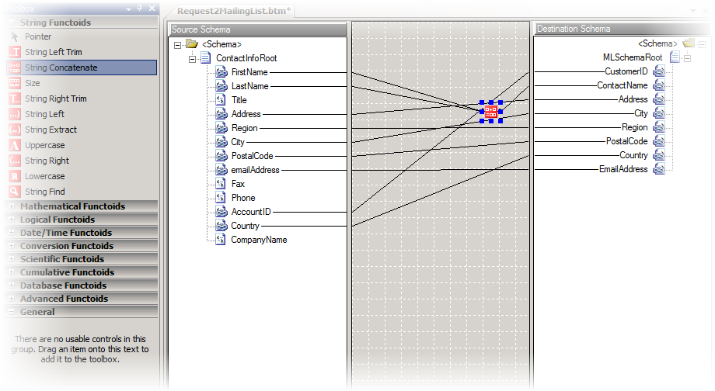
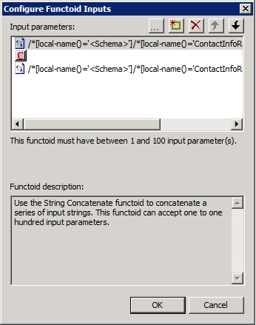
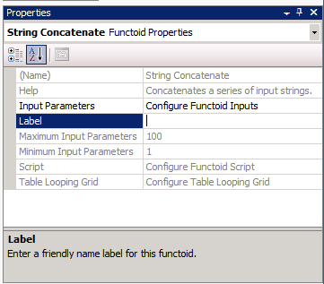
Adding Functoids to a Map
Grid
Functiod
Configuration
Toolbox

Slide 12
Demonstration: Adding Functoids to a Map
In this demonstration, you will see how to:
Add basic functoids to a map
Test a map
Create multiple map pages
Notes:
(Slide 12)
Open the solution at: C:\Demos\Mod3\Start\Mod3Demo2.sln (or continue on Demo1)
Open the existing map Customer_to_Contacts
Use the Concatenate shape to concatenate FirstName, MiddleName, LastName to Name
Test the map, review the output.
Create another map page, map Adresses.
Test the map, review the output.

Slide 13
Lesson 3: Configuring Advanced Functoids
Using Advanced Functoids
Using Looping Functoids
Using Database Functoids
Using a Scripting Functoid
Demonstration: Configuring Advanced Functoids

Slide 14
Using Advanced Functoids
Use Advanced functoids to:
Manage looping records
Define conditional mapping
Define custom scripts
Copy the entire elements of data

Slide 15
Using Looping Functoids
Looping functoids include:
Looping functoid
Index functoid
Record Count functoid
Table-driven functoids:
Table Looping functoid
Table Extractor functoid

Slide 16
Using Database Functoids
Database functoids:
Used to extract data from a database
Uses ADO datasets
Database functoids include:
Database Lookup
Error Return
Format Message
Value Extractor

Slide 17
Using a Scripting Functoid
Scripting functoid
Use when standard functoids do not provide required results
Can call an external .NET assembly
Supported languages
Visual Basic
C#
Java Script XSLT
XSLT Call Template

Slide 18
Demonstration: Configuring Advanced Functoids
In this demonstration, you will see how to:
Use the Iteration functoid
Use the Equal functoid
Notes:
(Slide 18)
Open the solution at: C:\Demos\Mod3\Start\Mod3Demo3.sln (or continue on Demo1 or Demo2)
Open the existing map Customer_to_Contacts
Go to the map page Adresses
Add an Iteration functoid and a Equal functoid to output only the first (1) adress
Test the map, review the input – where each Customer have two adresses, review the output – where only one adress exists per customer.

Slide 19
Summary
Maps are used to transform data between two formats
The Mapper is a graphical layer on top of XSLT
Functoids can be used to add logic and do more complex transformations
BizTalk Server enables you to use Visual Studio to Validate, Test and Debug a map.

Slide 20
Q & A
Maps

Slide 21


Hands-On-Labs
Working with Maps
Create a map using the BizTalk Mapper
Add functiods to a map
Validate a map
Build a map project
Debug a map

Slide 22

Quiz
What are the steps necessary to create, build and test a map in Visual Studio?
What does the scripting functoid do?

